Slide 1
GLOVER
PLATFORM FOR CREATING GRAPHICAL INTERFACES FOR INDUSTRIAL DRONES
AEROLOGOS
BRICS+FUTURE SKILLS & TECH CHALLENGE 2024
Here is where the future begins

Slide 2
TABLE OF CONTENTS
01
02
03
04
05
AEROLOGOS
INTRODUCTION
ADVANTAGES
DOCUMENTATION
PHOTOS
DEMONSTRATION

Slide 3
01
INTRODUCTION
AEROLOGOS

Slide 4
INTRODUCTION
AEROLOGOS
In the world of speeds the technologies are constantly changing.
The bar of the technical requirements in a sphere of industrial drones is perpetually rising.
Here is where the flexible solutions come into place.
Glover is a solution that fits such requirements.

Slide 5
02
ADVANTAGES
AEROLOGOS

Slide 6
ADVANTAGES
AEROLOGOS
PROVIDES A USER INTERFACE AND BUILDING BLOCKS FOR INTERACTING WITH UAVS
LOWERS THE INTELLECTUAL BAR FOR ENTRY TO PROCESS OF DEVELOPING UAV CONTROL SYSTEMS
DESIGNED FOR USERS WITH TECHNICAL SKILLS WHO DO NOT HAVE A BASE IN SOFTWARE PROGRAMMING
CROSS-PLATFORM

Slide 7
03
DOCUMENTATION
AEROLOGOS

Slide 8
LINKS
AEROLOGOS
GLOVER
GITHUB: https://github.com/aerologos/Glover
YOUTUBE SHORTS: https://www.youtube.com/shorts/FBkyM7M7tIY
YOUTUBE VIDEO: https://www.youtube.com/watch?v=vpVwevA3Wz8

Slide 9
04
PHOTOS
AEROLOGOS

Slide 10
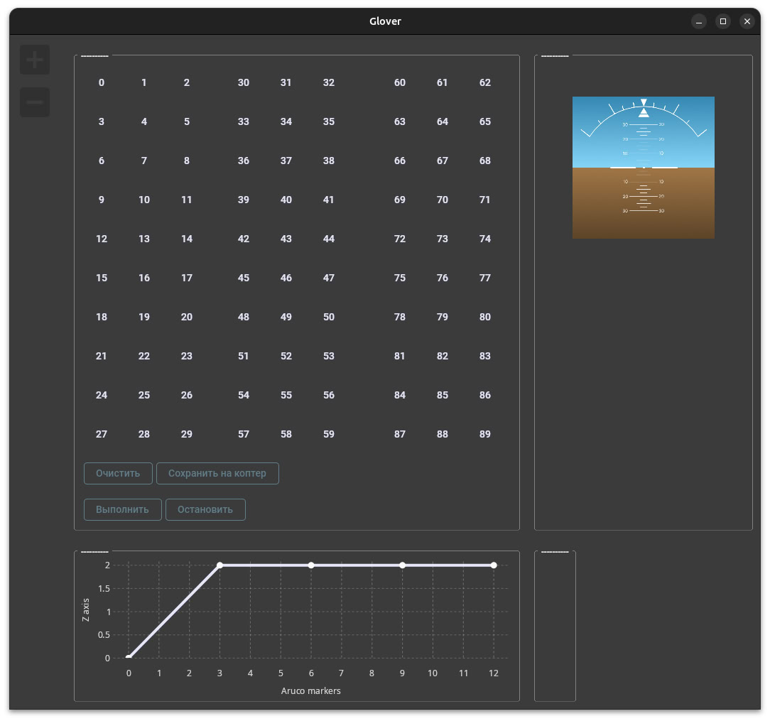
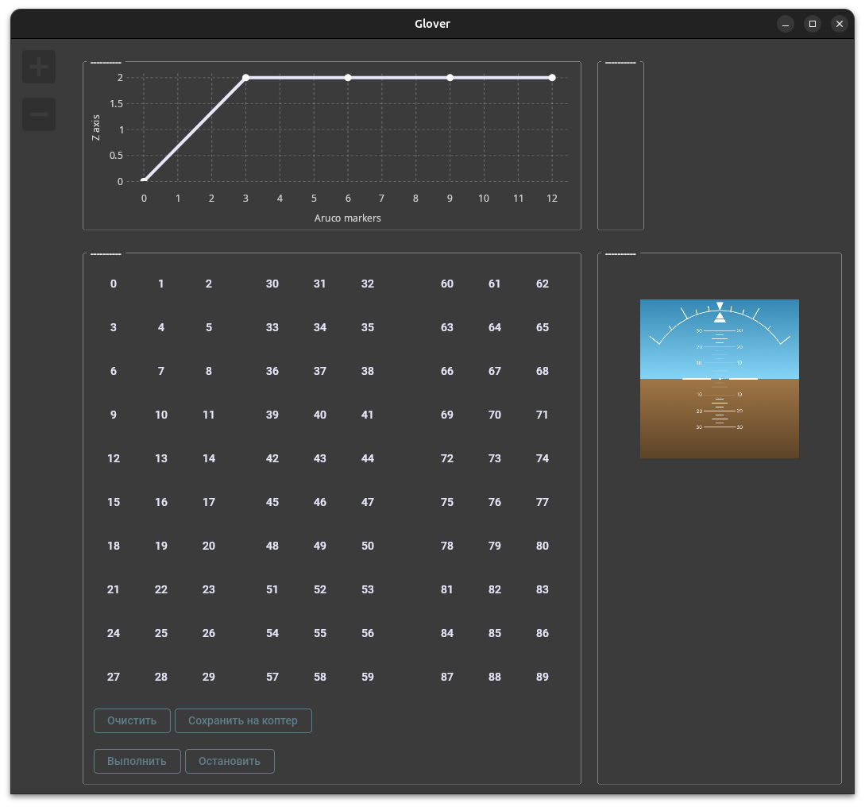
DIFFERENT LAYOUTS
AEROLOGOS

Slide 11
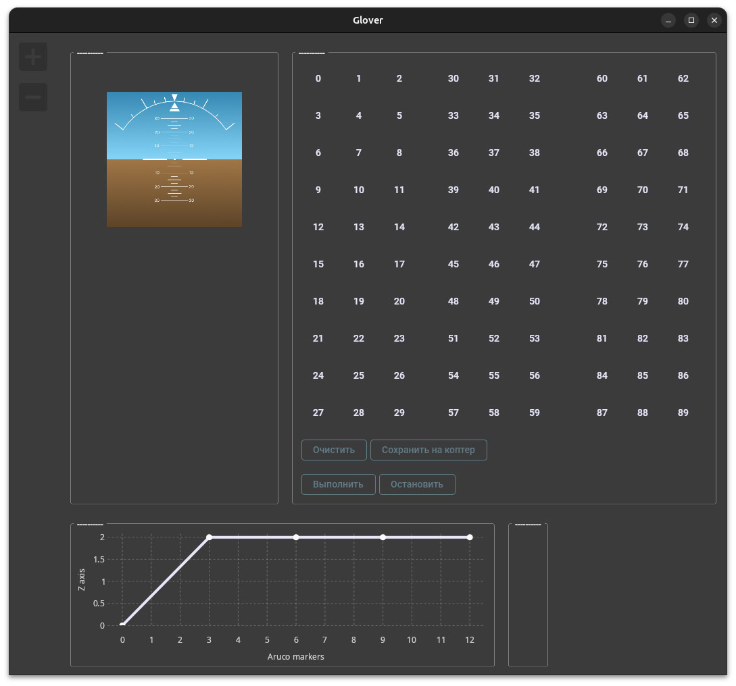
DIFFERENT LAYOUTS
AEROLOGOS

Slide 12
05
DEMONSTRATION
AEROLOGOS

Slide 13
LET’S FLY
AEROLOGOS

Slide 14
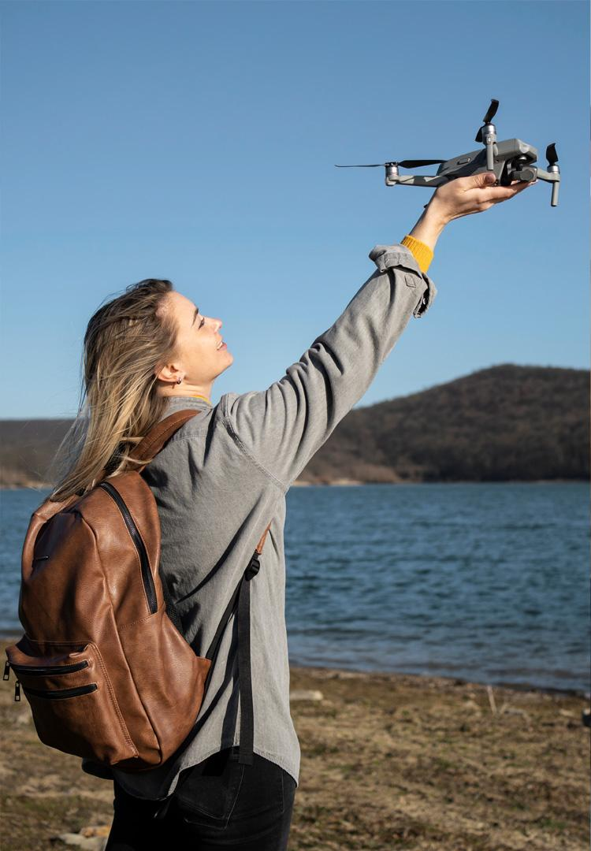
AEROLOGOS
GLOVER
PLATFORM FOR CREATING GRAPHICAL INTERFACES FOR INDUSTRIAL DRONES

